Slide 1
CSE3042 Machine Intelligence for Medical Image Analysis
J-Component
Skin Leasion Classification using deep learning methods
Daksh Bagga
20BAI1157

Slide 2
Skin Leasion Classification using deep learning methods

Slide 3
Contents
01
02
03
04
05
06
Problem Statement
Research Gap
Novelty
Abstract
07
Literature Survey
Modules Planned
Methodologies

Slide 4
Introduction
Due to its ability to provide effective information for improved visual and experimental analysis, computer vision methodology has drawn the attention of researchers in today's real-time everyday life scenario. A promising method in the computer vision approach is picture classification, which is utilized for a variety of tasks, including pattern detection, remote sensing, processing medical images, etc. Pixel sorting from an image and accumulation into distinct classes are the processes involved. Different techniques have been developed to efficiently identify and recognize the image class.
The Dermatology remains the foremost uncertain and sophisticated branch of science due to its complicacy in the procedures involved in diagnosis of diseases associated with hair, skin, nails. These diseases vary frequently because of several regional and environmental variables. The presence of hair, variations in tone, and other mitigating factors make human skin one of the most unpredictable and problematic surfaces. A number of pathological laboratory tests are used in the diagnosis of skin diseases to determine the appropriate disease. These diseases have been a source of worry for the past ten years because of how quickly they appeared and how complicated they were, increasing the risks to human life. Because these skin abnormalities are highly contagious, it is important to treat them early on to stop them from spreading. Overall welfare, including both physical and emotional health, is negatively impacted. Many of those skin abnormalities can be lethal, especially if they are not treated right away. Human mentality frequently assumes that most skin abnormalities aren't as serious as they are stated, thus they use their own curative techniques. However, if these treatments are ineffective for that specific skin condition, it gets worse. The current diagnosis process entails protracted laboratory tests, but this paper suggests a solution that will allow users to forecast skin illness using computer vision.

Slide 5

Problem Statement
Nowadays, people are suffering from skin diseases. More than one hundred thirty million people are affected by Psoriasis. Skin cancer is swiftly growing over the last few decades, especially Melanoma, which is the most diverse type of skin cancer. Dermatophytosis rate is high especially in rural areas. If skin diseases are not treated at an earlier stage, then it may lead to complications in the body including spreading of the infection from one individual to the other. Skin diseases can be prevented by investigating the infected region at an early stage. So with our project, this can be solved.
Normalizing the skin tone, so that it works for everyone.
Another issue is The characteristics of the skin images are diversified, so that’s a challenging job to devise an efficient and robust algorithm for detection of skin diseases.

Slide 6
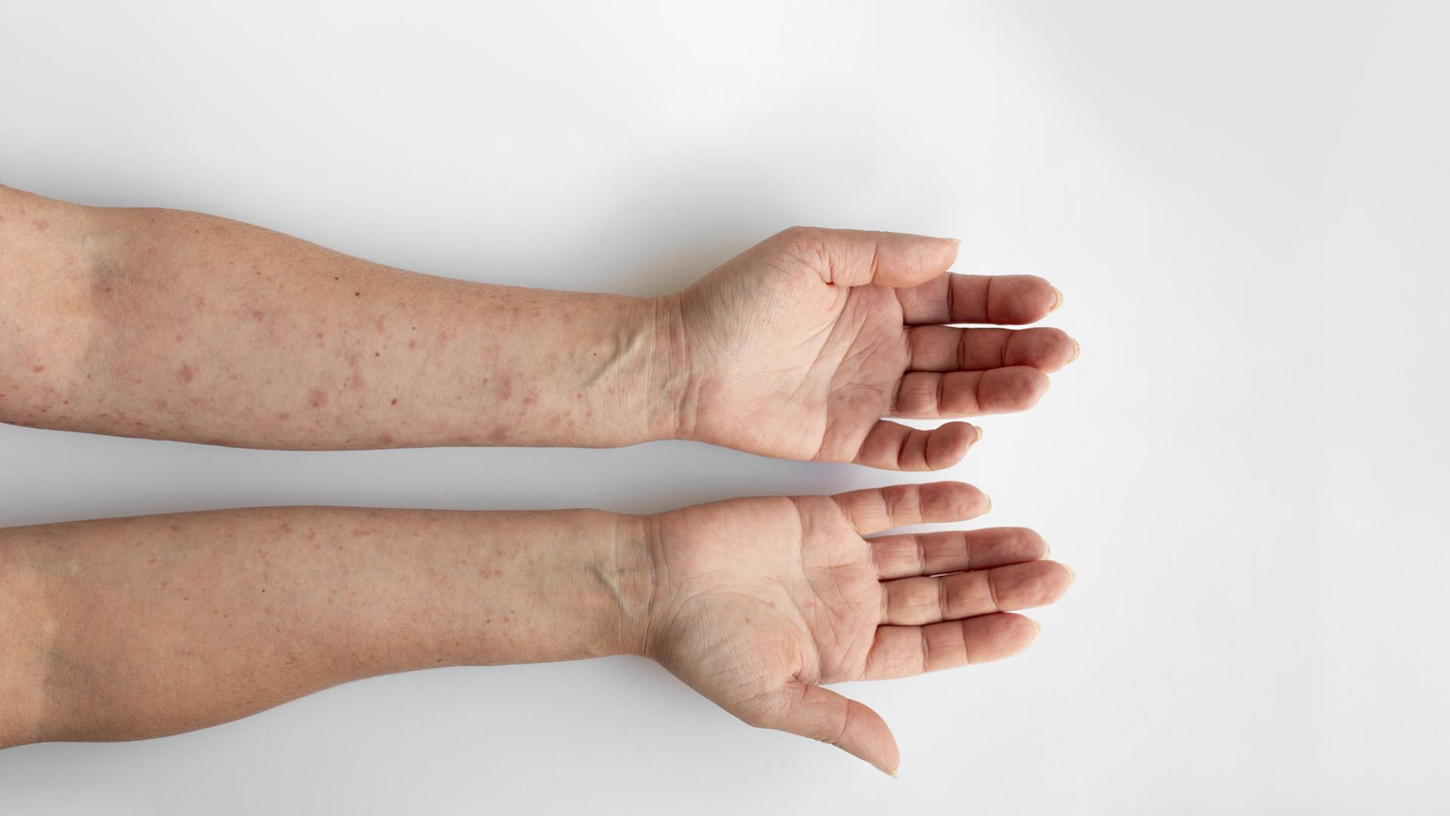
This picture is tells a story about skin diseases

Slide 7

Research Gap
Skin disorders are the fourth most frequent cause of skin burden globally. An accurate and automated method has been developed to lessen this load and let patients make an early assessment of the skin lesion. We learned from our preliminary research that there hasn't been any comparison of various Deep Learning models or work that has concentrated on the many metrics comparison of well-known deep learning algorithms for the classification of skin diseases. Therefore, we will compare different deep learning classification models with hyper-parameter tuning in our project, make our conclusions, and work on the user interface for the real-time skin disease diagnosis.
Novelty
Increasing the accuracy of the referred model.
Adding more levels(examples of different diseases)to detect from the images in the code
Graphical User Interface which refers to both the testing dataset images and real time skin images to detect the disease specified.

Slide 8
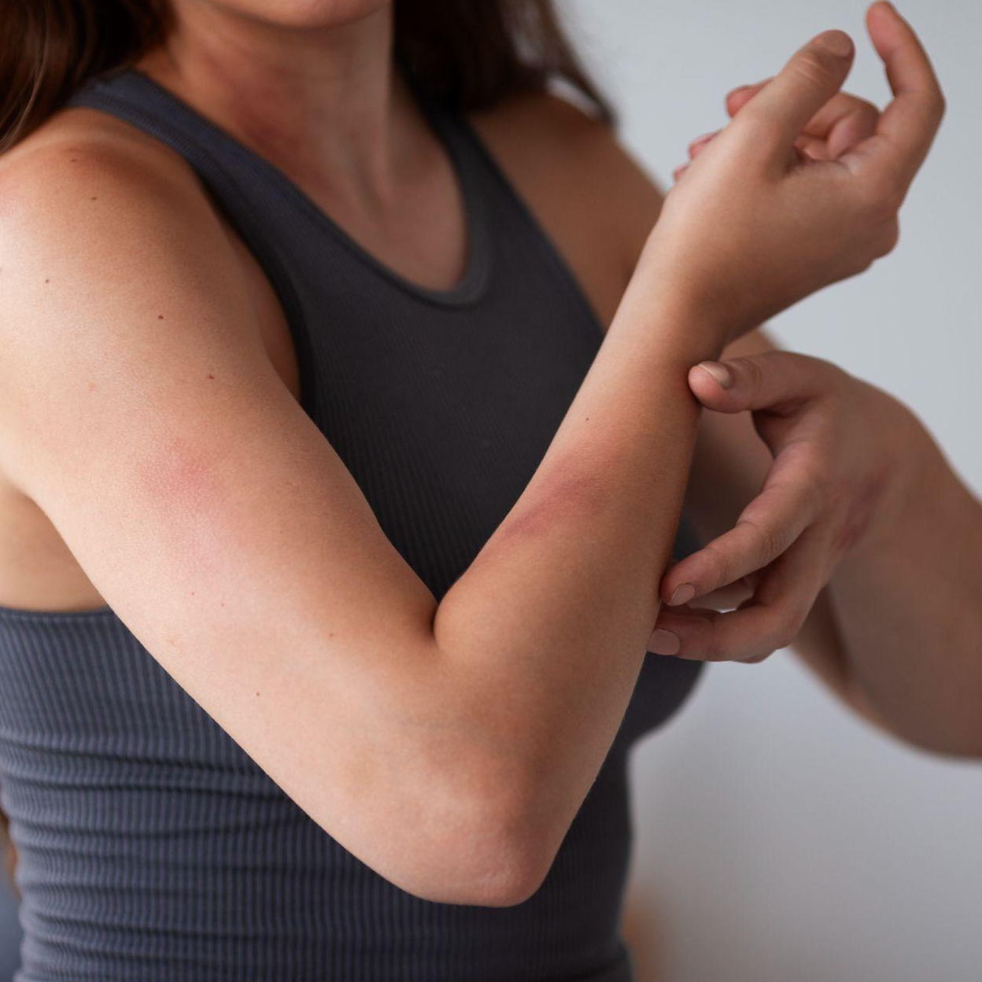
Abstract
Skin is an extraordinary human structure. It often suffers from several far-famed and unknown diseases. According to dermatology, it is a regular practice to do extensive tests on patients to ascertain the kind of skin illness they have been afflicted with. The duration of time varies from one practitioner to the next, depending on their experience. Therefore, diagnosis of human skin diseases is the most unsure and sophisticated branch of science. it's been ascertained that the majority of the cases stay disregarded due to the shortage of higher medical infrastructure and facilities. Our work aims at providing an automated image-based method for diagnosing and categorizing skin problems that uses image processing and machine learning classification. With an easy-to-use User Interface.

Slide 9
Literature Review
Paper-1
Automatic Malignant and Benign Skin Cancer Classification Using a Hybrid Deep Learning Approach
The purpose of this research paper was to create a hybrid method to classify skin cancer as malignant or benign as there is rise of using digital technology such as machine learning and deep learning in medical science. The current methods which are used in today's world are deep neural network, support vector machine, random forest and k-means classification. The methodology proposed in the paper is by first splitting the data in the ration 7:3 for training and testing. Then the data(images) were sent for primary feature extraction which was done using Resnet50, Xception, VGG16. The hybrid method includes training the data on 3 levels using SVM, NN, RF and k-means. The results were compared using different feature extraction methods.
In the first level, the initial training data is trained using a deep learning network and the results are called prediction 1. This then acts as a feature for level 2. This feature along with the extracted features are then again trained for level 2 using machine learning algorithms like SVM, RF, k-means. The results are then called prediction 2 and this acts as a feature for level 3. This results are passed for classification in level 3 and the results obtained are the final results.
Accuracy, Sensitivity, F1 score, AUC score are used as the metrics for evaluating the performance of the proposed model. For all these metrics, the proposed method was found to have better performance compared to other methods such as GaussianNB, Adaboost, Regression etc. Out of the 3 feature extraction methods(Resnet50, Xception, VGG16) Xception was giving the better performance with 90.9% accuracy.

Slide 10
Paper-2
Skin Cancer Classification Using K-Means Clustering
The purpose of this research paper was to create an automatic medical image classification method to classify two major types of skin cancer which are 'melanoma' and 'non-melanoma'. The methodology proposed by this research paper is to first use k-means clustering to extract the color and texture features from the input images using segmentation. With the help of local binary pattern plus color percentiles the features and then trained and tested on different types of classifiers and the accuracies are collected.
The university first collected the data required for the classification which consists of 75 melanoma images and 75 non-melanoma images. As part of pre-processing the images have been resized to 128*128. The resized images are then sent for segmentation using the k-means clustering algorithm and the features are then used by the classifiers and accuracies are compared.
The 4 different classifiers used to train the features extracted from clustering are Nearest Neighborhood(NN), Nearest Mean Classifier(NMC), Linear Classifier, and Support Vector Classifier(SVC). Out of all the classifiers, SVC was found to give the best performance while classifying the input images.

Slide 11
Paper-3
The Melanoma Skin Cancer Detection and Classification using Support Vector Machine
The purpose of this research paper is to propose a non-invasive medical computer vision or medical image processing method which can help to better classify skin cancer in a fast and accurate manner. The steps involved in this study include pre-processing, segmentation using thresholding, statistical feature extraction using Gray Level Co-Occurrence matrix(GLCM), Asymmetry, Border, Color, Diameter etc, feature selection using PCA (Principal Component Analysis) and then classification using Support Vector Machine.
The input images are first converted from RGB to gray scale and then contrast enhancement, Histogram modification and Noise filtering are performed to make the segmentation more accurate. The images after pre-processing then undergo segmentation to find the region of interest (ROI). This stage includes steps such as Image thresholding, image filling, image opening, converting extracted region to gray level, and then performing histogram equalization to the extracted gray level image. After segmenting the ROI, the features are then extracted using algorithms like Gray Level Co-Occurrence Matrix (GLCM). PCA is then performed on the extracted features in order to reduce the number of features extracted since some of the features maybe ineffective for the accuracy. The features finally obtained after the PCA stage are then trained using Support Vector Machine.
The proposed method was successful in generating a high accuracy for classifying the cancer as malignant or benign with the accuracy score of 90.2%.

Slide 12
Paper-4
Detection and Classification of Skin Diseases
The purpose of this research paper is to create a machine learning model to predict the skin cancers using methods like SVM. The need to create an effective automated screening system for disease identification and diagnosis has been brought on by the prevalence of skin disorders around the world. In this system, the function of colour information in identifying image edges was investigated. As a result, another colour space (HIS) is used. Laplace and Perwitt are two edge detection techniques that are used. The results reveal that Laplace is more effective at edge identification than Perwitt. In the study of image processing, the wavelet transform is very important for texture recognition of data. because of its excellent outcomes when employing multi-resolution modelling.
The “Wavelet Mother function” will receive the texture picture data and segment it into sub-bands. These sub-bands contain information about the feel, and after entering this information into a feature extraction process, the output serves as the input for a synthetic neural network (ANN), a potent tool for solving issues of enormous dimensions.
Skin conditions are now a very prevalent occurrence. Skin illnesses are affecting an increasing number of people. Skin disease diagnosis made by humans is typically imprecise and unreliable. Computer-aided diagnosis may be utilized to produce more accurate results that are dependable and objective. With improvements in medical imaging, image-based categorization is increasingly employed in the medical industry to identify disorders. To get the best results from any classifier, feature engineering is crucial. Convolution Neural Networks (CNN) can learn features on their own, which cuts down on the overall time needed to construct these systems while also enhancing accuracy. They obtained more than 850 original photographs for two skin conditions from the Skin and VD department of the KEM Hospital in Mumbai.

Slide 13
Paper-5
Automated Skin Disease Identification using Deep Learning Algorithm
The purpose of this research paper is to identify the skin diseases through images which are classified through deep learning algorithms. With the advancement of medical technology, the idea of using a computer to diagnose skin problems has recently become popular. Utilizing computer technology could improve human ability to comprehend complex information and make it easier to diagnose diseases from photographs of infected skin. All application industries, including healthcare, are adopting automation thanks to artificial intelligence.
Whereas it is challenging for a human to read such a large amount of data and delve into the nuances of the image inside, a computer can swiftly and effortlessly interpret a lot of photographs. Consequently, computer-aided detection and computer-based diagnosis have grown in popularity and are currently being developed by numerous research teams. Computer based diagnosis have proven to be very helpful in disease diagnosis.
Artificial Intelligence with Machine Learning is the most widely utilized technique for the prediction. Artificial intelligence (AI) use learning techniques to gain knowledge of the photos in order to anticipate diseases based on recurring patterns. The machine analyses the photos, processes the image slices, and makes predictions.

Slide 14
Paper-6
Enhanced Skin Condition Prediction Through Machine Learning Using Dynamic Training and Testing Augmentation
In this study, the authors have proposed a dynamic training and testing augmentation in a position to significantly improve performance. This study's framework for searching augmentation is faster on the GPU than a traditional search algorithm, which must train a new model each time on offer. Using Bayesian optimization, the search algorithm can be sped up so that we do not have to train a new model each time a new augmentation policy is suggested on a trained model.
Their approach's performance is contrasted with that of a single model, and an ensemble model is also the ISIC 2019 challenge champion. They’ve also used the most recent compact yet significant technology EfcientNet, a precise network architecture, which serves as the system's backbone.
Finally, This study suggests a method for investigating the likelihood of having numerous probabilistic training enhancement inference, as well as dynamic augmentation seeking. Although the proposed method has high accuracy, more steps are needed to train the model. The low convergent rate of our method is due to achieving stochastically tuned weight, which is rarely achieved using minimum augmentation.

Slide 15
Paper-7
Artificial intelligence in dermatology past, present, and future
This research article mentions and details about the significance of AI in dermatology. The term artificial intelligence (AI) was first used in 1956 at a renowned Dartmouth College conference. All disciplines are gradually becoming interconnected, and AI has permeated every aspect of medicine. The potential of AI in the life sciences was discovered by medical researchers in the early 1970s.
The majority of diagnoses in dermatology are made using visual pattern recognition and morphological features. The field of dermatology is ideally suited for the application of AI image recognition technologies for aided diagnosis. Dermoscopy, very high-frequency (VHF) ultrasound, and reflectance confocal microscopy (RCM) are the three skin imaging technologies currently available. Each type of skin imaging technology has benefits and drawbacks of its own. In order to accurately diagnose various skin lesions, dermatologists must use various imaging techniques. With widespread acceptance and use around the globe, skin imaging technology has emerged as a crucial tool for the clinical diagnosis of skin diseases.
Finally, they've concluded mentioning it's issue as well, including. Even though dermatological AI has advanced quickly in recent years, it has run into obstacles in the clinic and faces a number of urgent issues.
They also discussed the anticipated development of dermatology AI, stating that many developed nations around the world have actively developed strategic plans for its advancement and elevated its advancement to a new strategic era in recent years.

Slide 16
Paper-8
Multi-type skin diseases classification using OP-DNN based feature extraction approach
This research paper proposed the segmentation and classification method for identifying skin lesion regions in 2015. In order to achieve this, skin photos are first placed into a filtering procedure to remove extraneous noise, and hair sections are then segmented. The region growth approach was used for segmentation, which automatically set seed sites for removing the lesion area from the skin. As a result, elements of colour and texture identify the lesion region that is removed. The merging of Support Vector Machine and k-nearest neighbor classifiers was then used for illness categorization.
They showed face-related skin disease identification using convolutional neural network technology in later years. China's skin image collection, a larger clinical skin-related dataset with 2656 face photos, was taken for analysis from Xiangya-Derm for this reason. For analysis, these input photos rely on three significant skin conditions—BCC, SCC, and SK—as well as additional prevalent conditions like lupus erythematosus (LE), rosacea (ROS), and actinic keratosis (AK). Five widely used network algorithms were created by the authors to categorize these diseases in a dataset. The deep CNN-based Inception-v3 has also been presented by X. Fan et al. They created a method for identifying the noise in the image.
The classification of skin lesion locations was carried out after such obtrusive contents were removed. Here, Dermofit Image Library from the University of Edinburgh input dataset photos are subjected to impulse noise, Gaussian noise, and noise composed using the compound of the two in order to remove the noise elements. The classifier begins to classify the skin illness once the noise has been reduced.

Slide 17
Paper-9
Automatic skin disease diagnosis using deep learning from clinical image and patient information
In this research study, the authors have proposed an automated system for the diagnosis of five common skin diseases by using data from clinical images and patient information using deep learning pre-trained mobilenet-v2 model. It also explains about the ways with which the authors have used deep learning from clinical images and patient information to detect skin diseases
For methods, Clinical images were acquired using different smartphone cameras and patient's information were collected during patient registration. Different data preprocessing and augmentation techniques were applied to boost the performance of the model prior to training.
The authors were able to get a satisfied result For the common five skin diseases, their proposed technique has produced multiclass classification accuracy, sensitivity, and precision values of 97.5, 97.7, and 97.7 percent, respectively. The findings show that the developed system has a very high diagnostic performance for the five skin diseases.
Finally, they’ve designed the planned system as a mobile phone application and the authors also feel that it has the potential to be used as a decision support system in places with scarce resources, where both the availability of qualified dermatologists and the resources themselves are constrained.

Slide 18
Paper-10
Opportunities and Challenges: Classification of Skin Disease Based on Deep Learning
In this Paper the Author aims to, Provide a quick review of the classification of skin disease using Deep Learning to summarize the characteristics of skin lesions and the status of image technology, to study the characteristics of skin diseases and review the research on skin disease classification using deep Learning, analysis of the study using datasets, data processing, classification models and evaluation criteria.
The image effect of non-dermoscopic photographs can be influenced by the unpredictability of imaging conditions, such as shooting angle, light, and storage pixels. The table above is a collection of selected published datasets that include more than a dozen different types of skin conditions, with melanoma having the highest likelihood of occurring. However, the labeling of photographs is labor-intensive and time-consuming due to the lack of a unified standard for skin disease images, which significantly reduces the size of the current public datasets. Multiple datasets have thus been pooled for use in many investigations.
In order to address the rising number of patients with skin diseases and lessen the burden on the limited number of dermatologists, deep learning can be applied. One might anticipate that a deep learning-based skin disease recognition system will be made available to intelligent gadgets to better serve more people as mobile phones, mobile computers, and wearable technology become more and more popular. It will be an intelligent skin disease diagnosis and treatment.

Slide 19
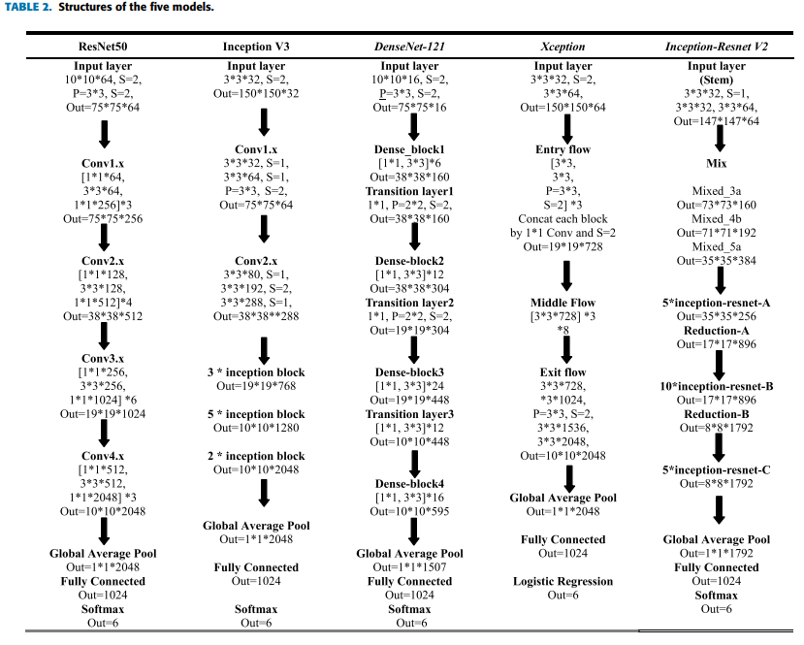
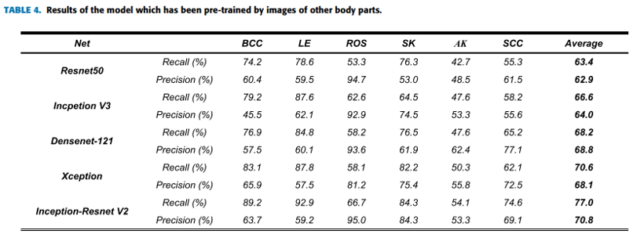
Paper-11
Studies on Different CNN Algorithms for Face Skin Disease Classification Based on Clinical Images
In this paper the author studied different CNN algorithms for face skin disease classification based on the clinical images. First, from Xiangya–Derm, which is China’s largest clinical image dataset of skin diseases, the author established a dataset that contains 2656 face images belonging to six common skin diseases [seborrheic keratosis (SK), actinic keratosis (AK), rosacea (ROS), lupus erythematosus (LE), basal cell carcinoma (BCC), and squamous cell carcinoma (SCC)]. Then the author performed studies using five mainstream network algorithms to classify these diseases in the dataset and compared the results. Then, they performed studies using an independent dataset of the same disease types, but from other body parts, to perform transfer learning on their models.
Comparing the performances, the models that used transfer learning achieved a higher average precision and recall for almost all structures. In the test dataset, which included 388 facial images, the best model achieved 92.9%, 89.2%, and 84.3% recalls for the LE, BCC, and SK, respectively, and the mean recall and precision reached 77.0% and 70.8%.

Slide 20
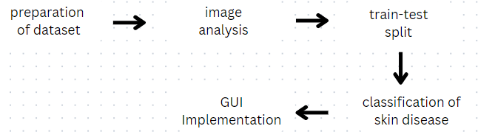
Modules Planned

Slide 21
Modules Planned
Data Collection : In this module we are going to collect the dataset from the open source available skin disease datasets and consolidate it to one dataset
Enhancement and Preprocessing : Analyzing the Dataset and performing Data Augmentation on the Images and increase the Size of the dataset especially the rarely found skin disease dataset and then making the dataset ready for applying the Deep Learning Models
Model Planning : Planning on what all models we are going to implement and defining the structure of the model.
Training the model

Slide 22
Modules Planned
Testing the model with metrics: Using a test dataset to test the model.
Comparison Analysis of all the models used : Here we are going to make a comparison between different models applied on our dataset based on the metrics.
Planning and Building the Graphical User Interface of the best fit model: In this module we are going to make a interactive Graphical User Interface using Tkinter where a user can upload photo of the affected skin area and the user can get the detailed analysis of the image and also the type of skin disease which will be useful for him/her to take precautions and approach the dermatologist.
Results and Conclusion: In this module we are going to consolidate our work.
Future Works: This is our final module planned where we are going to address the future scope for this project.

Slide 23
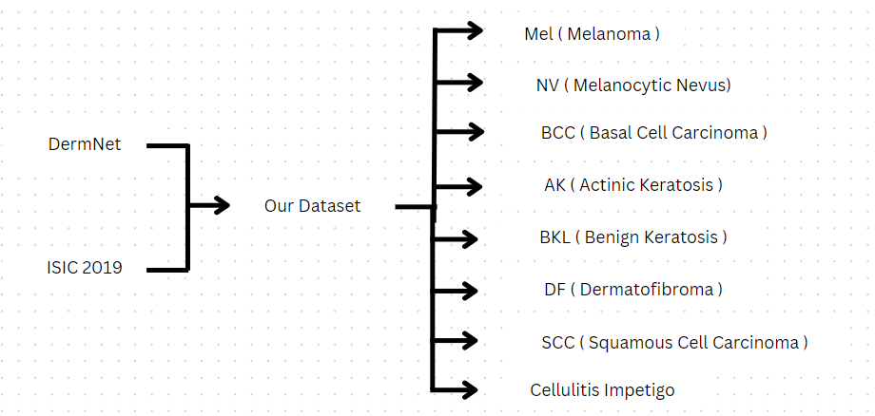

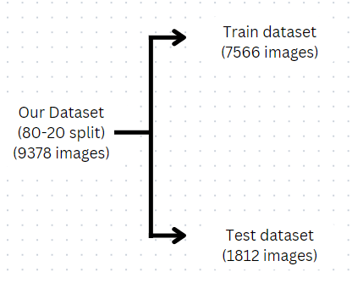
Dataset

Slide 24
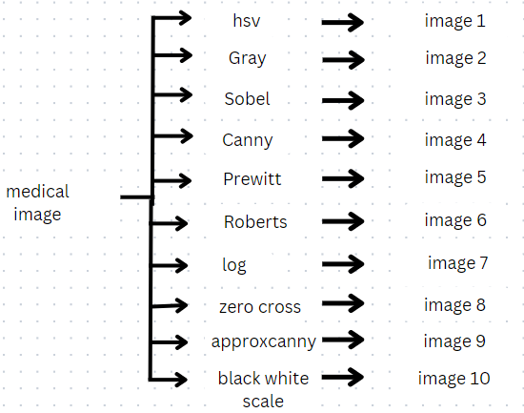
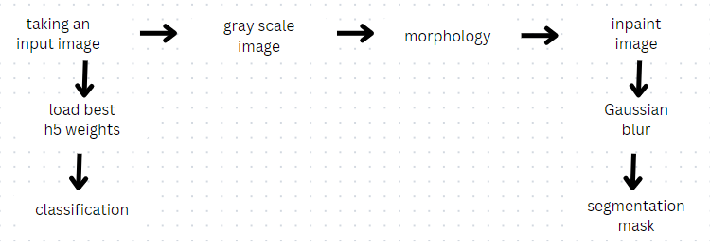
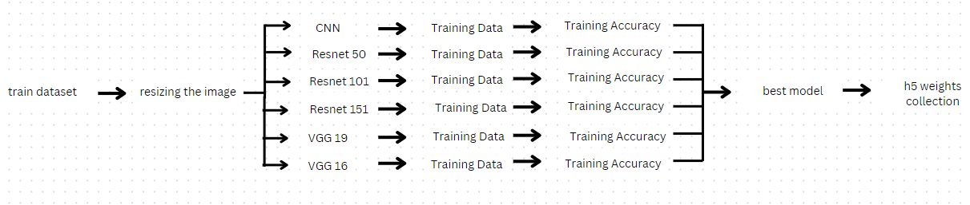
Methodology
Implementation

Slide 25
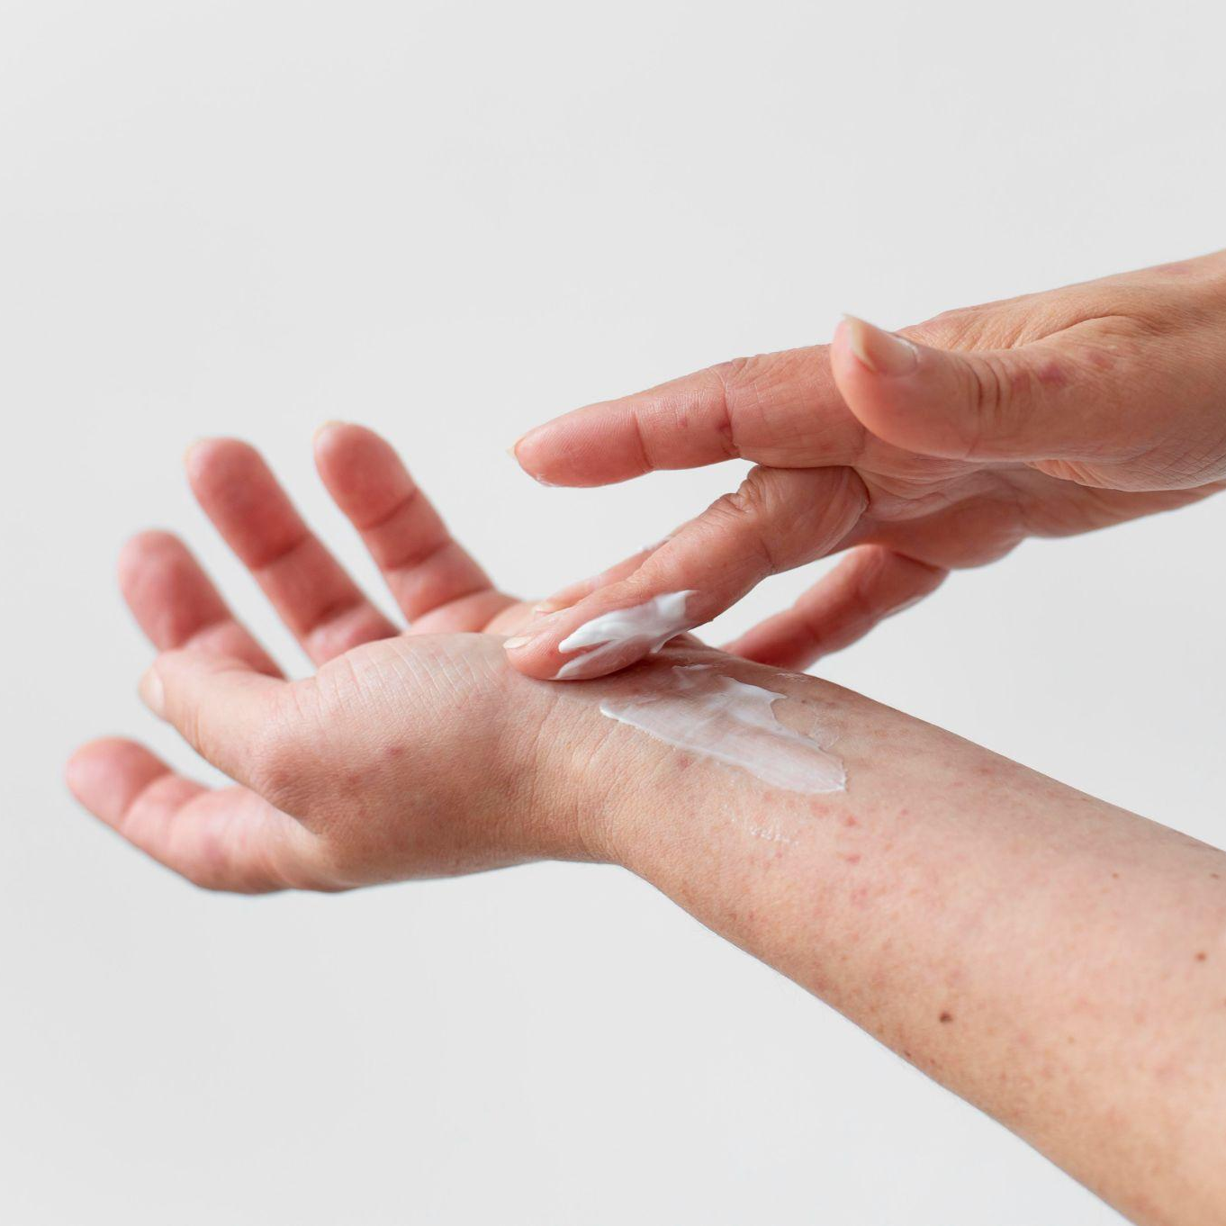
Methodologies
For the image analysis part of the project we will be doing preprocessing, filtering, segmentation and edge detection, whereas for the classification part of the project, we are planning to train the dataset using various deep learning models such as Convolutional Neural networks and Artificial Neural Networks. At the end, we will be using various JavaScript and python modules to implement the GUI part of the project.

Slide 26
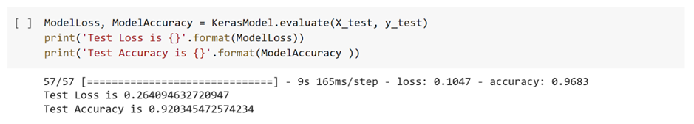
Results & Discussion - Our Model Accuracy

Slide 27
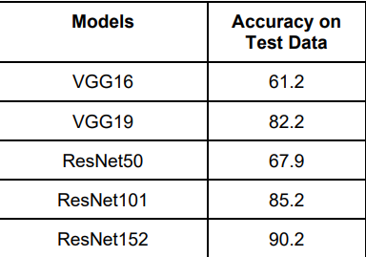
Results & Discussion- Model Comparison Table

Slide 28
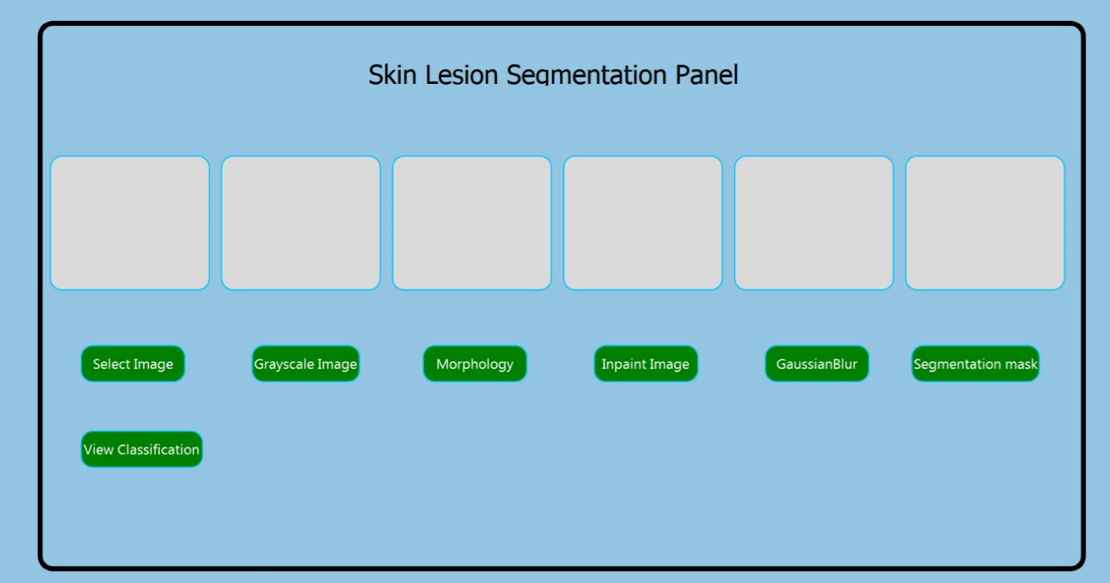
GUI Implementation

Slide 29
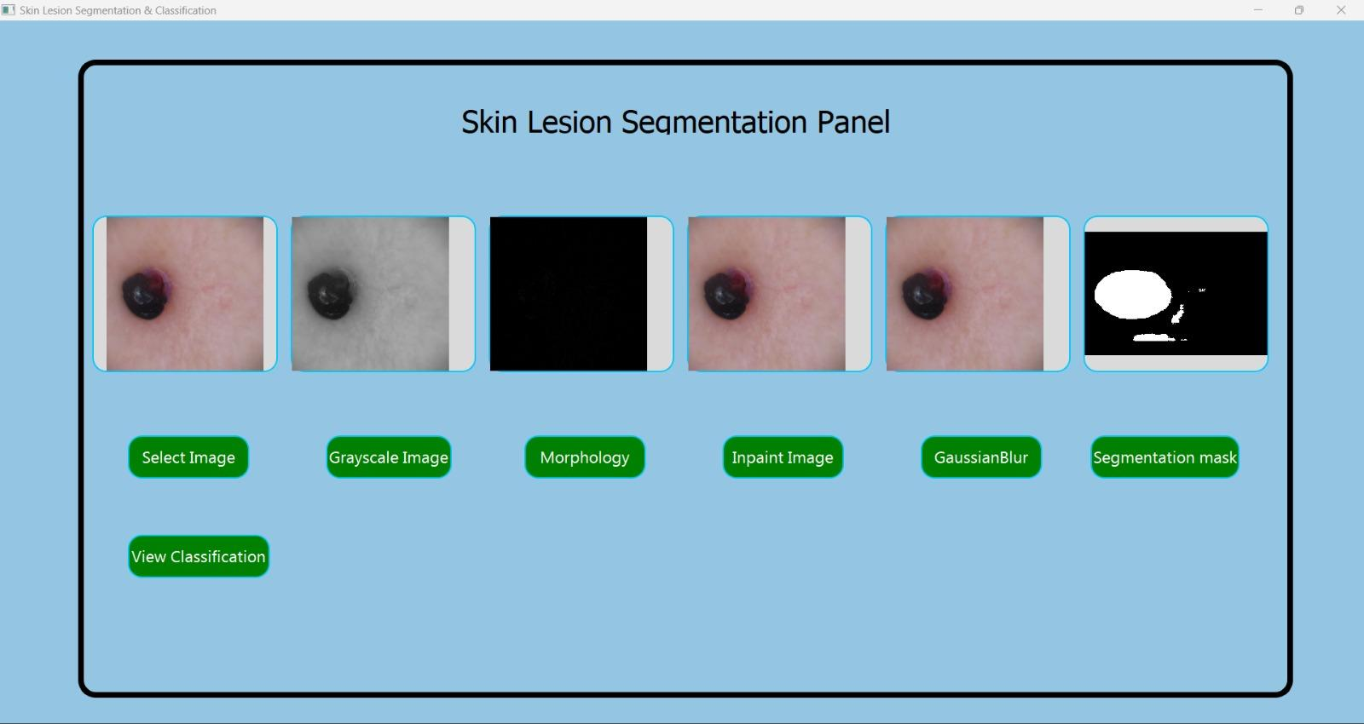
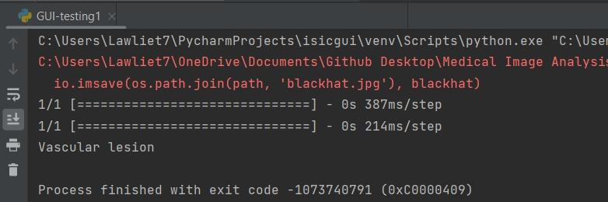

Slide 30
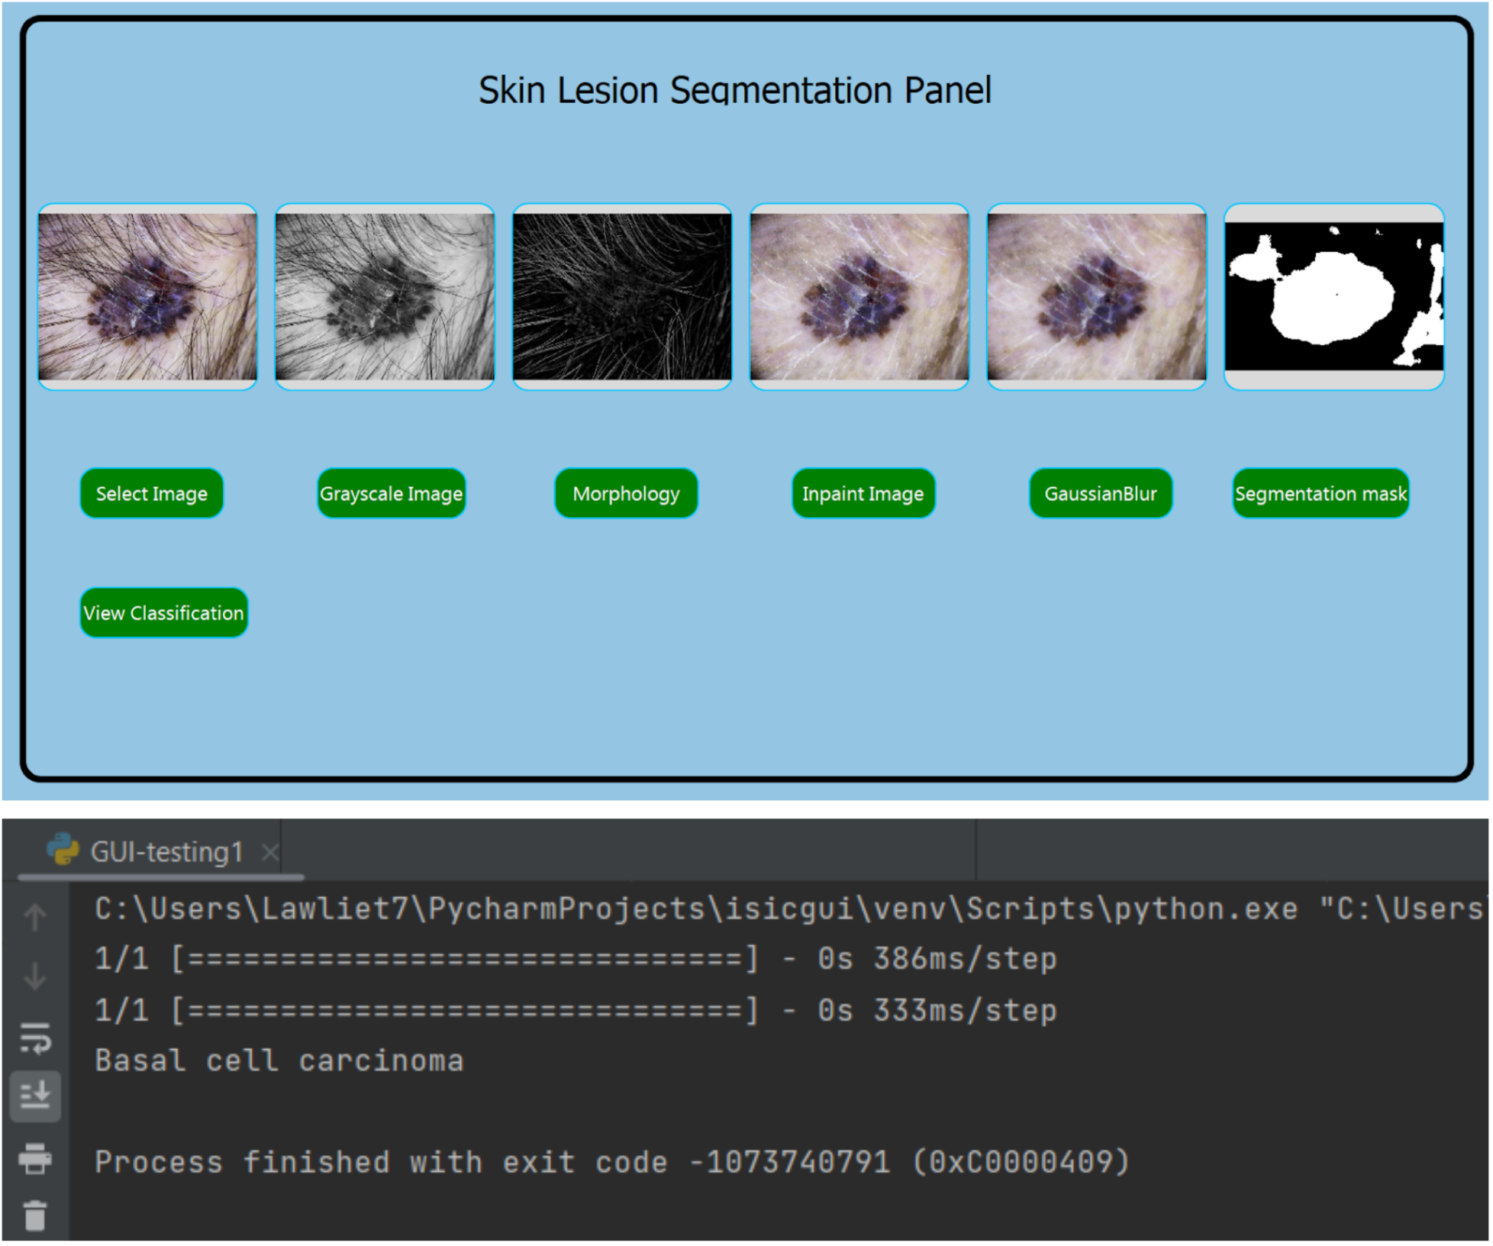

Slide 31
Conclusion & Future Works
We have successfully trained 6 different models, out of which our Deep CNN model has given the highest accuracy of 93.72% so we have saved its weights in the form of a h5 file and then the h5 file was used for our GUI which also has various Segmentation filters along with the classification. The segmentation filters used are: Gaussian Blur, Morphological, In paint, Segmentation mask, Grayscale.
This GUI implemented application can be used in Real Time, for any captured input, and our model will show all the required image analysis filters, along with the Real time Skin Disease classification results. Which can be used by anyone irrespective of in which place they live.
As a part of future work , we can add other Image analysis filters in the GUI for the more robust results. We can also try to fit other transfer learning models make the working more efficient, thereby reducing the time complexity in predicting the class and make it more user friendly.

Slide 32
Acknowledgement
We wish to express our sincere thanks and deep sense of gratitude to our project guide, Dr Malathi G, Associate Professor Senior , School of Computer Science and Engineering , for her consistent encouragement and valuable guidance offered to us in a pleasant manner throughout the course of the project work.
We are extremely grateful to. Dr A. Nayeemulla Khan, Dean of School of Computer Science VIT Chennai, for extending the facilities of the school towards our project and for their unstinting support.
We express our thanks to our Head of the Department Dr. Sweetlin Hemalatha for her support throughout the course of this project.
We also take this opportunity to thank all the faculty of the School for their support and their wisdom imparted to us throughout the course.
Furthermore, we thank our parents, family, and friends for bearing with us throughout the course of our project and for the opportunity they provided us in undergoing this course in such a prestigious institution.

Slide 33
References
https://www.sciencedirect.com/science/article/abs/pii/S0965997822002629
https://link.springer.com/content/pdf/10.1007/s11042-021-11823-x.pdf?pdf=button%20sticky
https://biomedpharmajournal.org/vol11no3/automated-skin-disease-identification-using-deep-learning-algorithm/
https://www.mdpi.com/2075-4418/12/10/2472
https://www.ijtra.com/view/skin-cancer-classification-using-k-means-clustering.pdf
https://ieeexplore.ieee.org/abstract/document/8257738
https://cjme.springeropen.com/articles/10.1186/s10033-021-00629-5#:~:text=Opportunities%20and%20Challenges%3A%20Classification%20of%20Skin%20Disease%20Based,5%20Skin%20Disease%20Classification%20Using%20Deep%20Learning%20
https://ieeexplore.ieee.org/document/8720210
https://cjme.springeropen.com/articles/10.1186/s10033-021-00629-5#:~:text=Opportunities%20and%20Challenges%3A%20Classification%20of%20Skin%20Disease%20Based,5%20Skin%20Disease%20Classification%20Using%20Deep%20Learning%20
https://onlinelibrary.wiley.com/doi/full/10.1002/ski2.81
https://ieeexplore.ieee.org/stamp/stamp.jsp?tp=&arnumber=9007729
https://www.ncbi.nlm.nih.gov/pmc/articles/PMC6793782/

Slide 34
Thank You!!

